Slide 1

Cricket Analytics using SQL
Uncovering Insights from IPL Data for Royal Challengers Bangalore
By: Yuvraj Gupta
Submission date : 31-10-25
Every match tells a story. Every number hides a clue. Let’s decode what the data reveals about one of IPL’s most unpredictable teams — RCB.
Uncovering Insights from IPL Data for Royal Challengers Bangalore

Slide 2
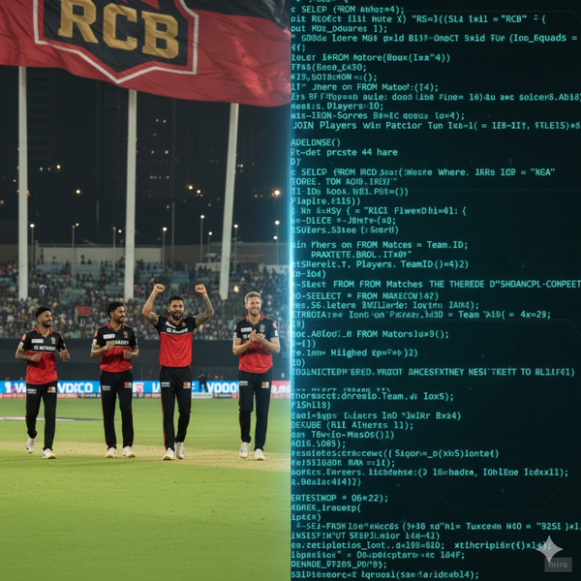
The Beginning: Why This Project?
The IPL is a data treasure.
This project analyzes match stats, player performance, and team strategies using SQL
To uncover the key patterns behind RCB’s wins and losses.
RCB — a team with legends, firepower, and passion. Yet the trophy cabinet stays empty. Why? Maybe, the answers lie in the data.

Slide 3
Objectives & Problem Statement
Problem Statement:
You’ve been hired as a sports data analyst by RCB to identify top-performing and cost-effective players for the 2017 mega auction. Your task is to develop data-driven strategies and suggestions to help the team build a winning squad.
Objectives:
Decode team & player patterns across seasons.
Identify KPIs that influence wins and losses.
Study how age, venue, and playing style impact outcomes.
Recommend a data-backed strategy for future success.

Slide 4
Knowing the Data
Dataset Summary:
Tables Used: 20
Size: 50,000+ records across multiple seasons
Data Scope: Batting, bowling, match outcomes, player demographics
Importance:
Enables end-to-end match analytics — from every ball to every player.
Every great story starts with understanding its characters. For us, that’s the data.

Slide 5
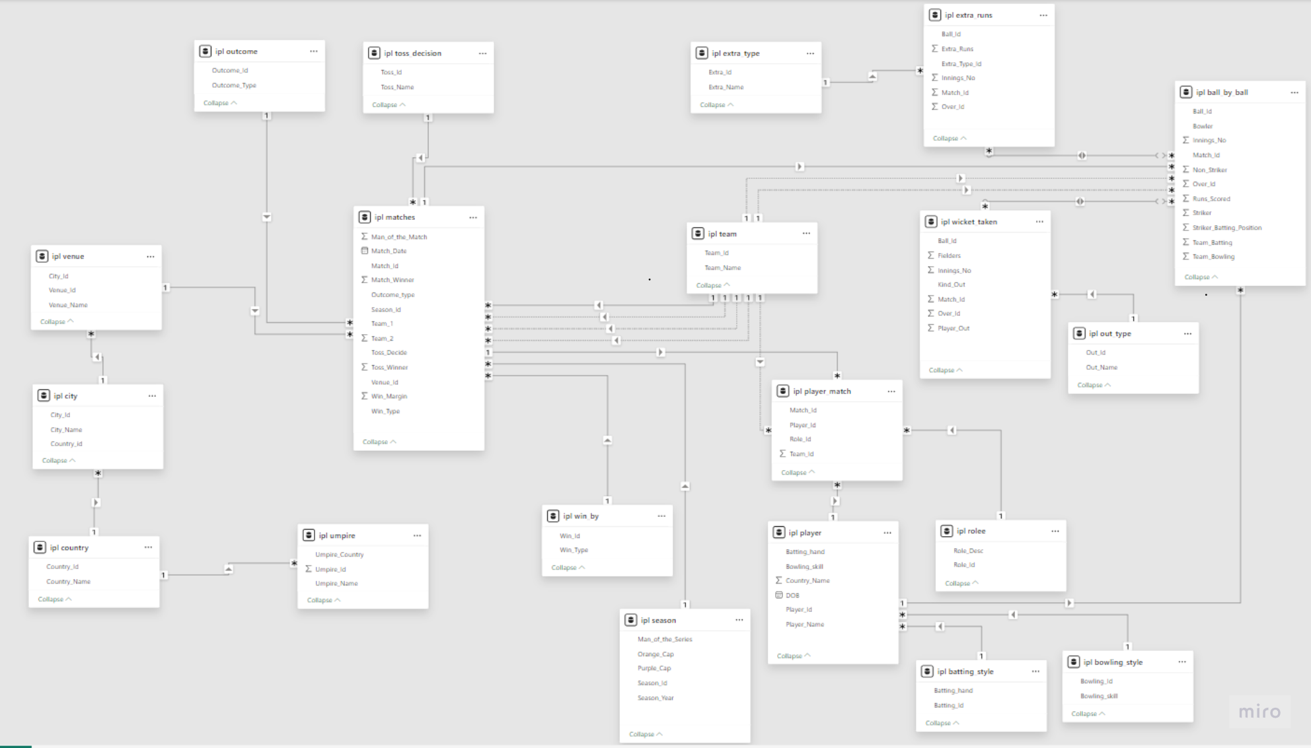
IPL Data Schema

Slide 6
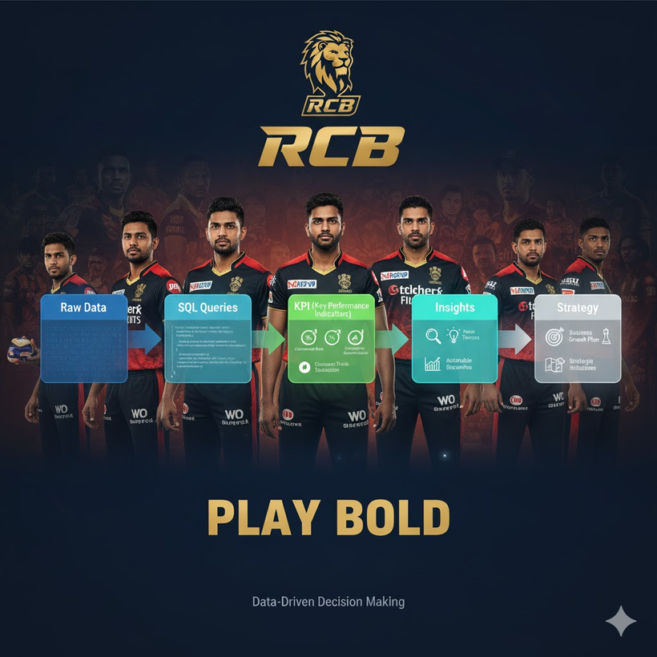
The Game Plan (Methodology)
Steps Taken:
Cleaned and validated data (team names, nulls).
Linked tables using joins and CTEs for structured queries.
Analyzed performance trends, player metrics, and venue outcomes.
Created new KPIs to evaluate team strategy.
Tools:
SQL for analysis
Excel / Power BI for visualization
Just like a cricket match, analysis needs a game plan. Here’s how we set up the innings.

Slide 7
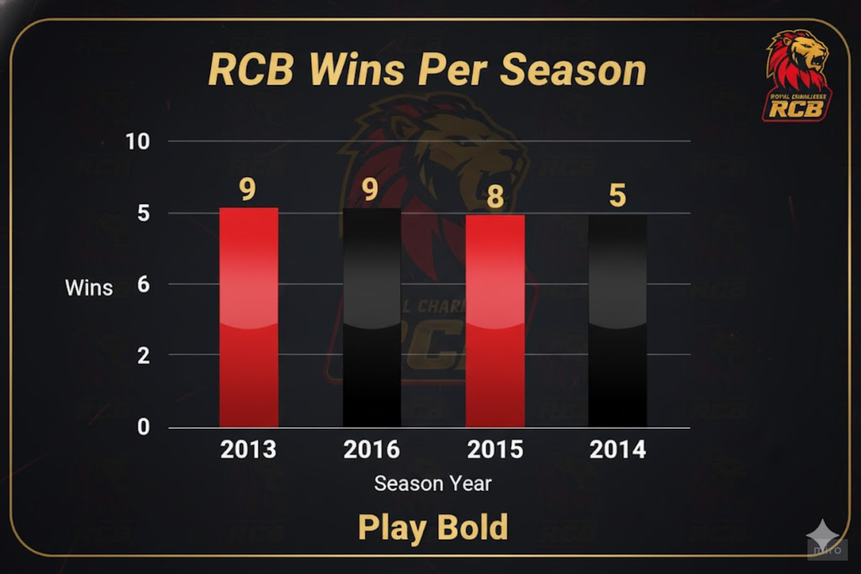
Reading the Scorecard (Findings 1)
Key Findings:
Season 1 data was incomplete, showing 0 runs for RCB.
In 2013, RCB won 9 matches — a mid-table performance.
In 2014, 89 players were over 25, indicating an experience-heavy squad.
Takeaway: Experience alone didn’t ensure consistent wins — the team needed better balance.
The scoreboard starts to speak. Let’s see what the early numbers told us.

Slide 8
Powerplay of Insights (Findings 2)
Batting Analysis:
Calculated average runs per batsman across seasons.
Identified top 10 players by strike rate (last 4 seasons).
Bowling Analysis:
Right-arm medium and fast-medium bowlers took the most wickets.
Spinners performed steadily but with fewer key breakthroughs.
player_name | total_runs
V Kohli | 1243
AB de Villiers | 1010
CH Gayle | 981
Yuvraj Singh | 289
DA Warner | 260
KL Rahul | 255
Q de Kock | 183
SR Watson | 166
PA Patel | 158
AM Rahane | 154
Now the data begins to reveal patterns — who shines, who struggles, and where momentum shifts.
Uncovering Insights from IPL Data for Royal Challengers Bangalore

Slide 9
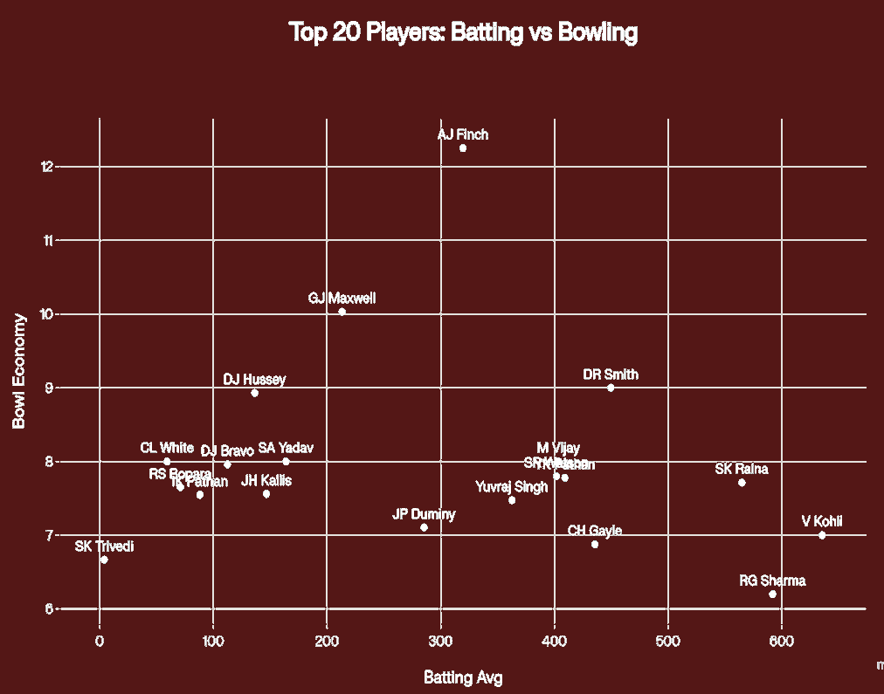
The Turning Point: Derived KPIs
Derived KPIs:
Win/Loss Ratio
Bowling Economy Rate
Average Runs per Wicket
Wicket-Taking Frequency
Key Insights:
Medium pacers led in wicket-taking.
Strong batting averages couldn’t offset weak bowling economy.
All-rounders (measured by runs + wickets × 20) delivered the best overall impact.
Now the story shifts from stats to strategy — the data starts suggesting what wins matches.
Uncovering Insights from IPL Data for Royal Challengers Bangalore

Slide 10
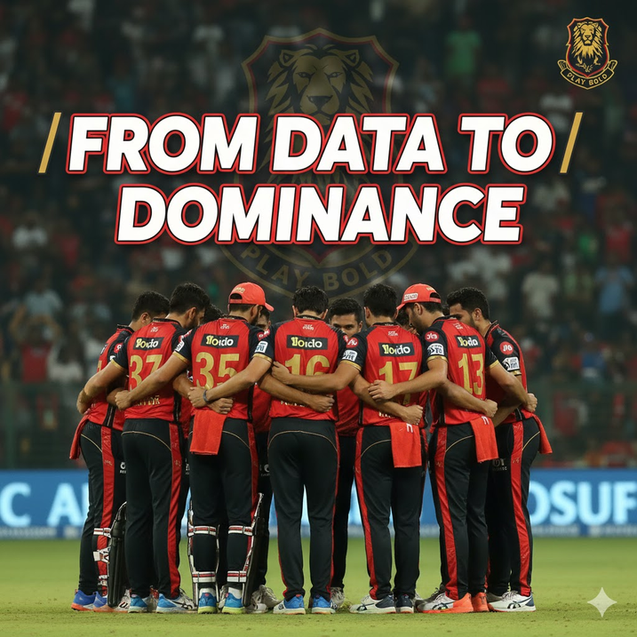
Strategic Recommendations (1/3)
Focus: Auction & Team Composition
Retain core players who consistently boost win percentage.
Prioritize all-rounders for both batting depth and bowling options.
Strengthen the fast-medium bowling unit, RCB’s most reliable wicket source.
Every insight now becomes a piece of strategy — it’s time to rebuild RCB’s winning blueprint.
Uncovering Insights from IPL Data for Royal Challengers Bangalore

Slide 11
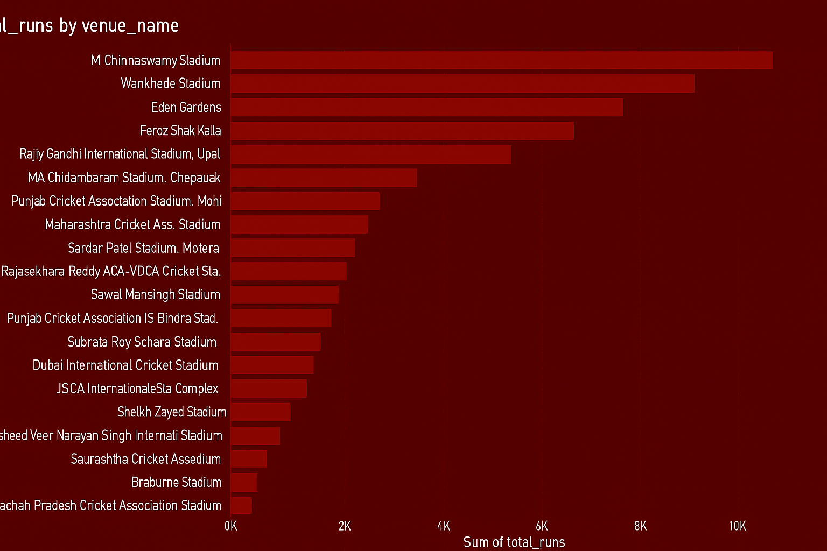
Strategic Recommendations (2/3)
Focus: Venue & Conditions Strategy
Maximize home advantage at Chinnaswamy, which favors strong batting.
Target bowlers who perform well in high-scoring grounds.
Use venue-specific player stats to guide selection and rotation.
Cricket is a game of context — pitches, crowds, and stadiums tell their own stories.

Slide 12
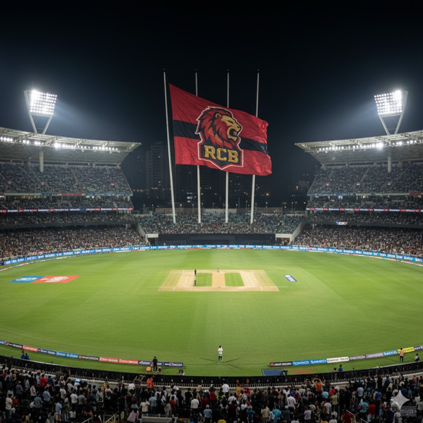
Strategic Recommendations (3/3)
Focus: Data-Driven Decision Making
• Use strike rate + economy KPIs before match selections.
• Track morale impact players — those whose presence boosts win %.
• Integrate SQL dashboards with live team analytics.
Data isn’t just a backend task — it’s the 12th man on the field.
Uncovering Insights from IPL Data for Royal Challengers Bangalore

Slide 13

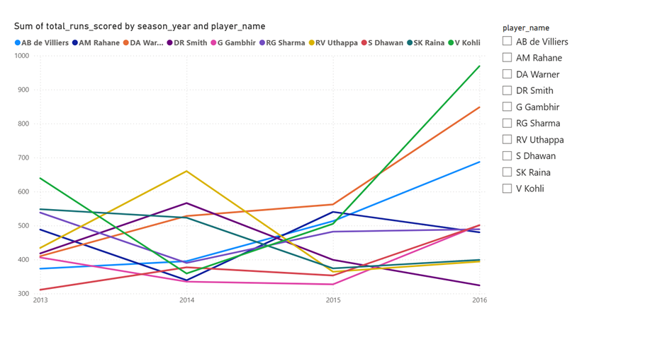
Players who performed consistently well
Every IPL season tells its own story — of rising stars, fading forms, and rare consistency.
From 2013 to 2016, few players like Virat Kohli and AB de Villiers made consistency their trademark — their runs reflecting focus, adaptability, and hunger to improve.
Rohit Sharma and David Warner showed flashes of brilliance, each with their own rhythm and impact.
In the end, it wasn’t just about runs — it was about reliability when it mattered most.
Consistency is what transforms average into excellence.

Slide 14
Conclusion
SQL analysis showed RCB’s imbalance between batting strength and bowling depth.
Venue conditions, player roles, and bowling styles significantly influenced match results.
All-rounders and pace bowlers emerged as the key contributors to success.
Data-driven strategies can redefine team composition and match planning.
Numbers don't lie — and in cricket, they tell the story behind every victory.
After every match, there’s reflection. After every analysis, there’s clarity.

